Slide 1
Tony Online Judge
Group 8: Mengqi Wu, Zhengyu Xie, Yiqing Yu

Slide 2
Introduction
Programming Language : Go
Final project: Online Judge System -- Tony Online Judge(TOJ) which can be used to practice for programming learner.
GitHub: https://github.com/kizzy8848/Spring-2023-Group-8

Slide 3
Introduction
Users can login/register to TOJ platform and select problems to do according to their category, or filter the questions by searching the question keywords. After users do the questions, click submit and the platform will judge whether it is correct according to the test cases. And the platform will also rank all users according to the number of passed problems.
Administrator can manage problems and manage category after logging into the platform.
3

Slide 4
Actors
User
Administrator
FIELD | TYPE
ID | int
Identity | string
Name | string
Password | string
Email | string
IsAdmin | Int: 0
FIELD | TYPE
ID | int
Identity | string
Name | string
Password | string
Email | string
IsAdmin | Int: 1

Slide 5
USE CASE
User
Login: If the user is not registered, enter username and password, then enter the email for verification; If the verification is successful, the registration is successful. if the user is registered, enter the correct email and password to log in the system.
Forget Password: If the user forgets their password, they can use their email to verify and reset the password.
Do Problems: The user selects one question, codes and submits it, and the system will determine if the code is correct.
View Submissions: The user can view its own submissions.
View Rank: The user can view users ranking list.

Slide 6
USE CASE
Administrator
Manage Category: Add, delete, edit and view category.
Administrators can view the list of users, view their records of questions
Manage Problems: Administrators can add, delete, modify and view questions.

Slide 7
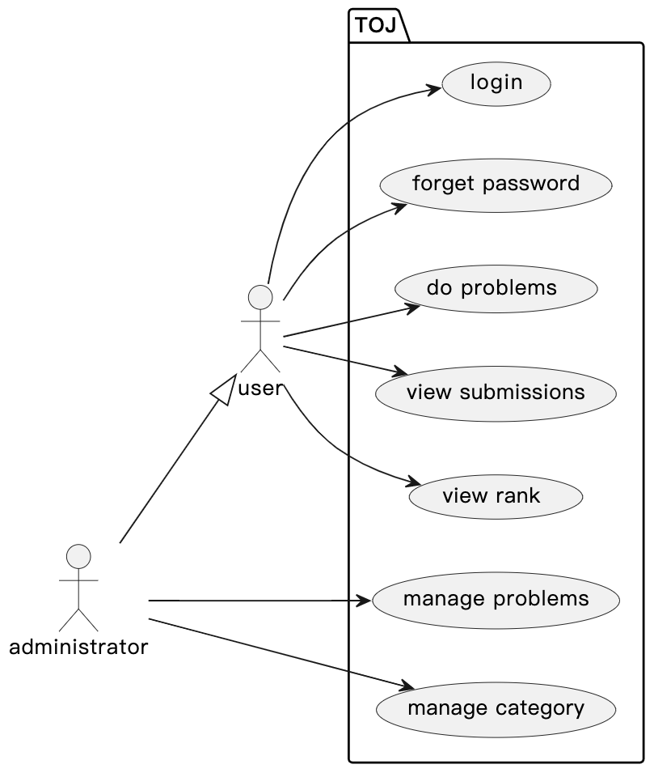
Use Case Diagram
7

Slide 8
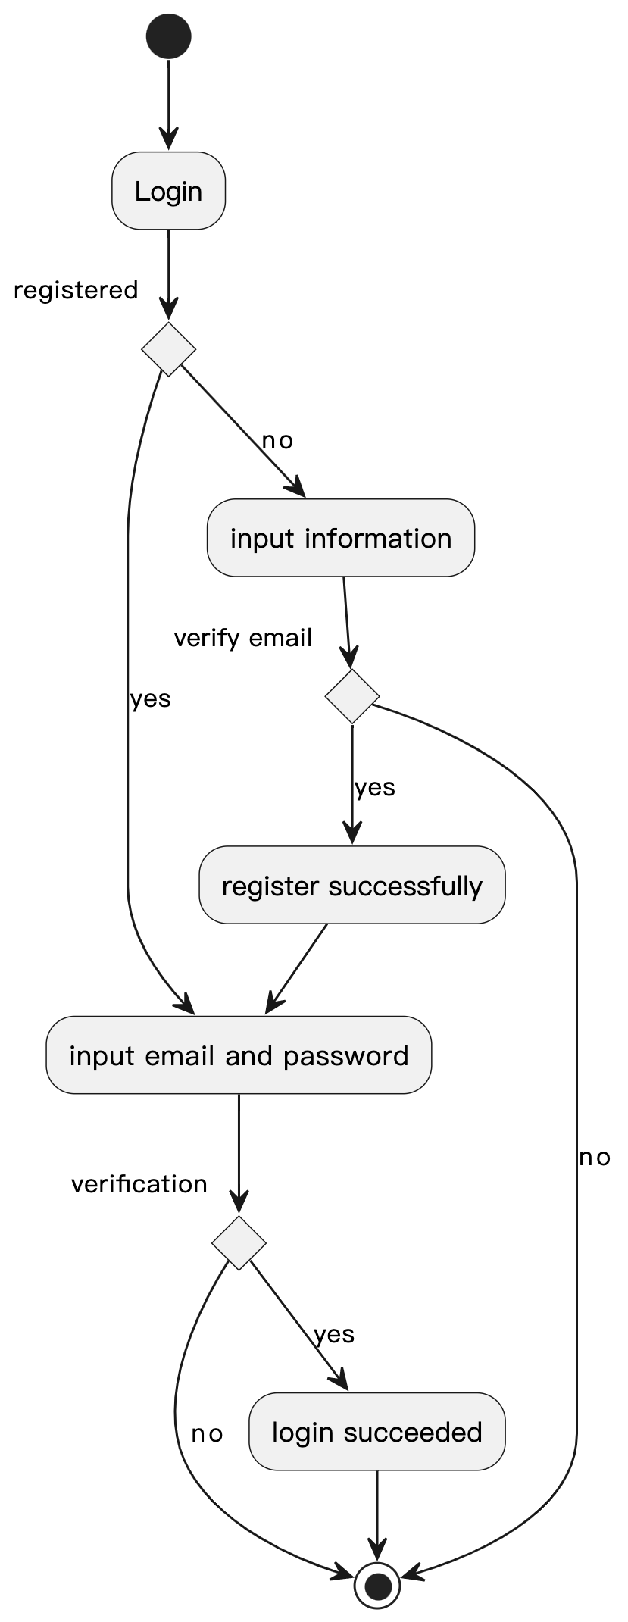
Activity Diagram
Login
8

Slide 9
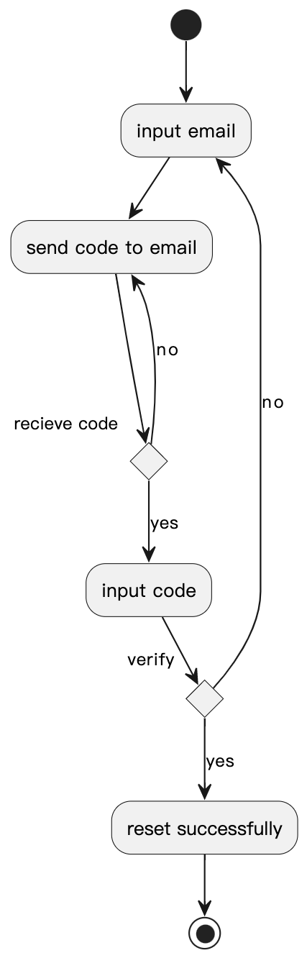
Activity Diagram
Forget Password
9

Slide 10
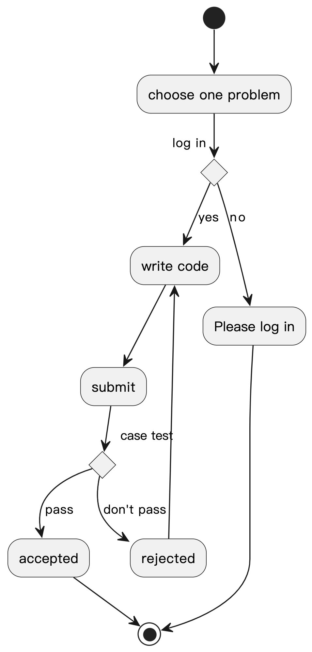
Activity Diagram
Do Problems
10

Slide 11
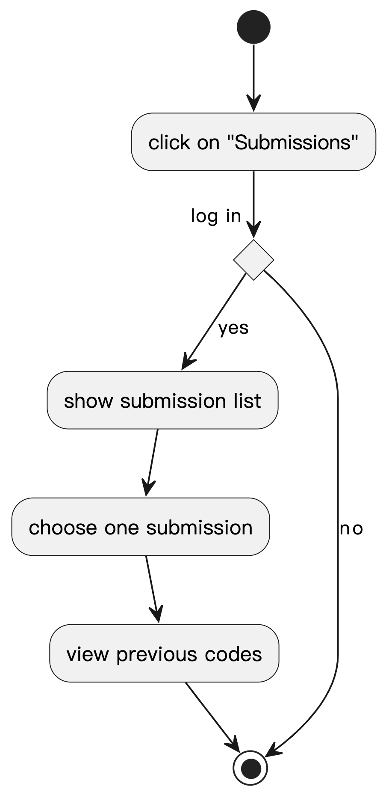
Activity Diagram
View Submissions
11

Slide 12
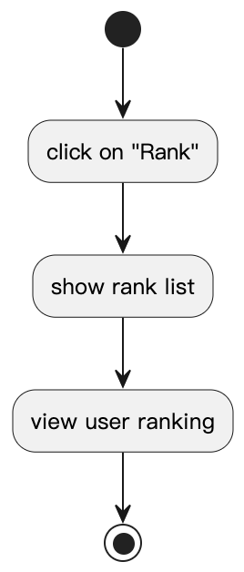
Activity Diagram
View Rank
12

Slide 13
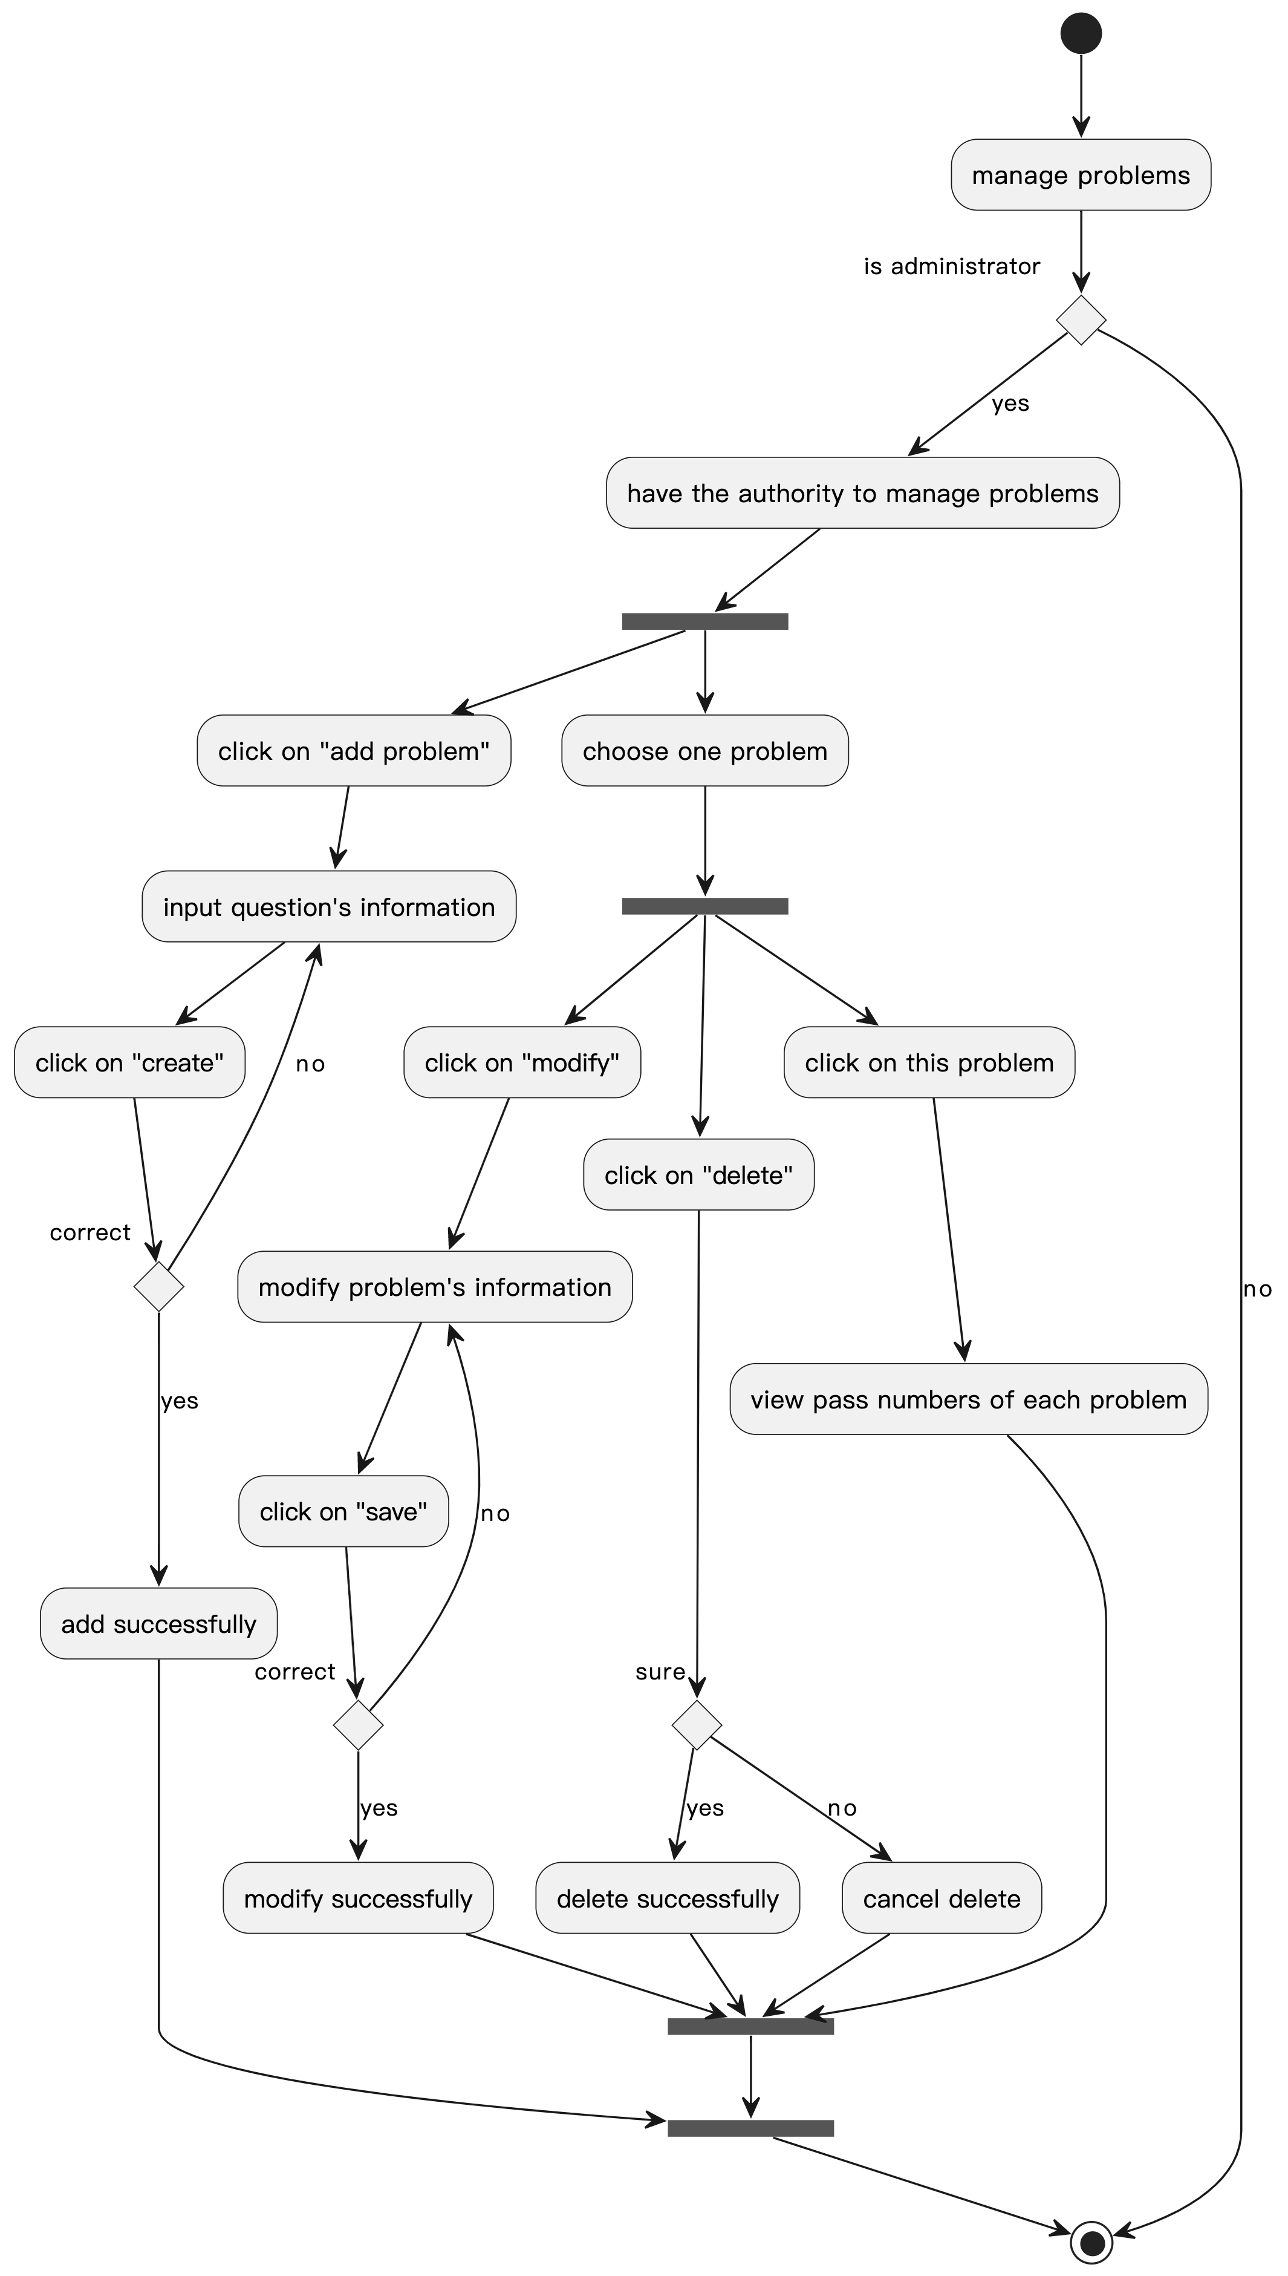
Activity Diagram
Manage Problems
13

Slide 14
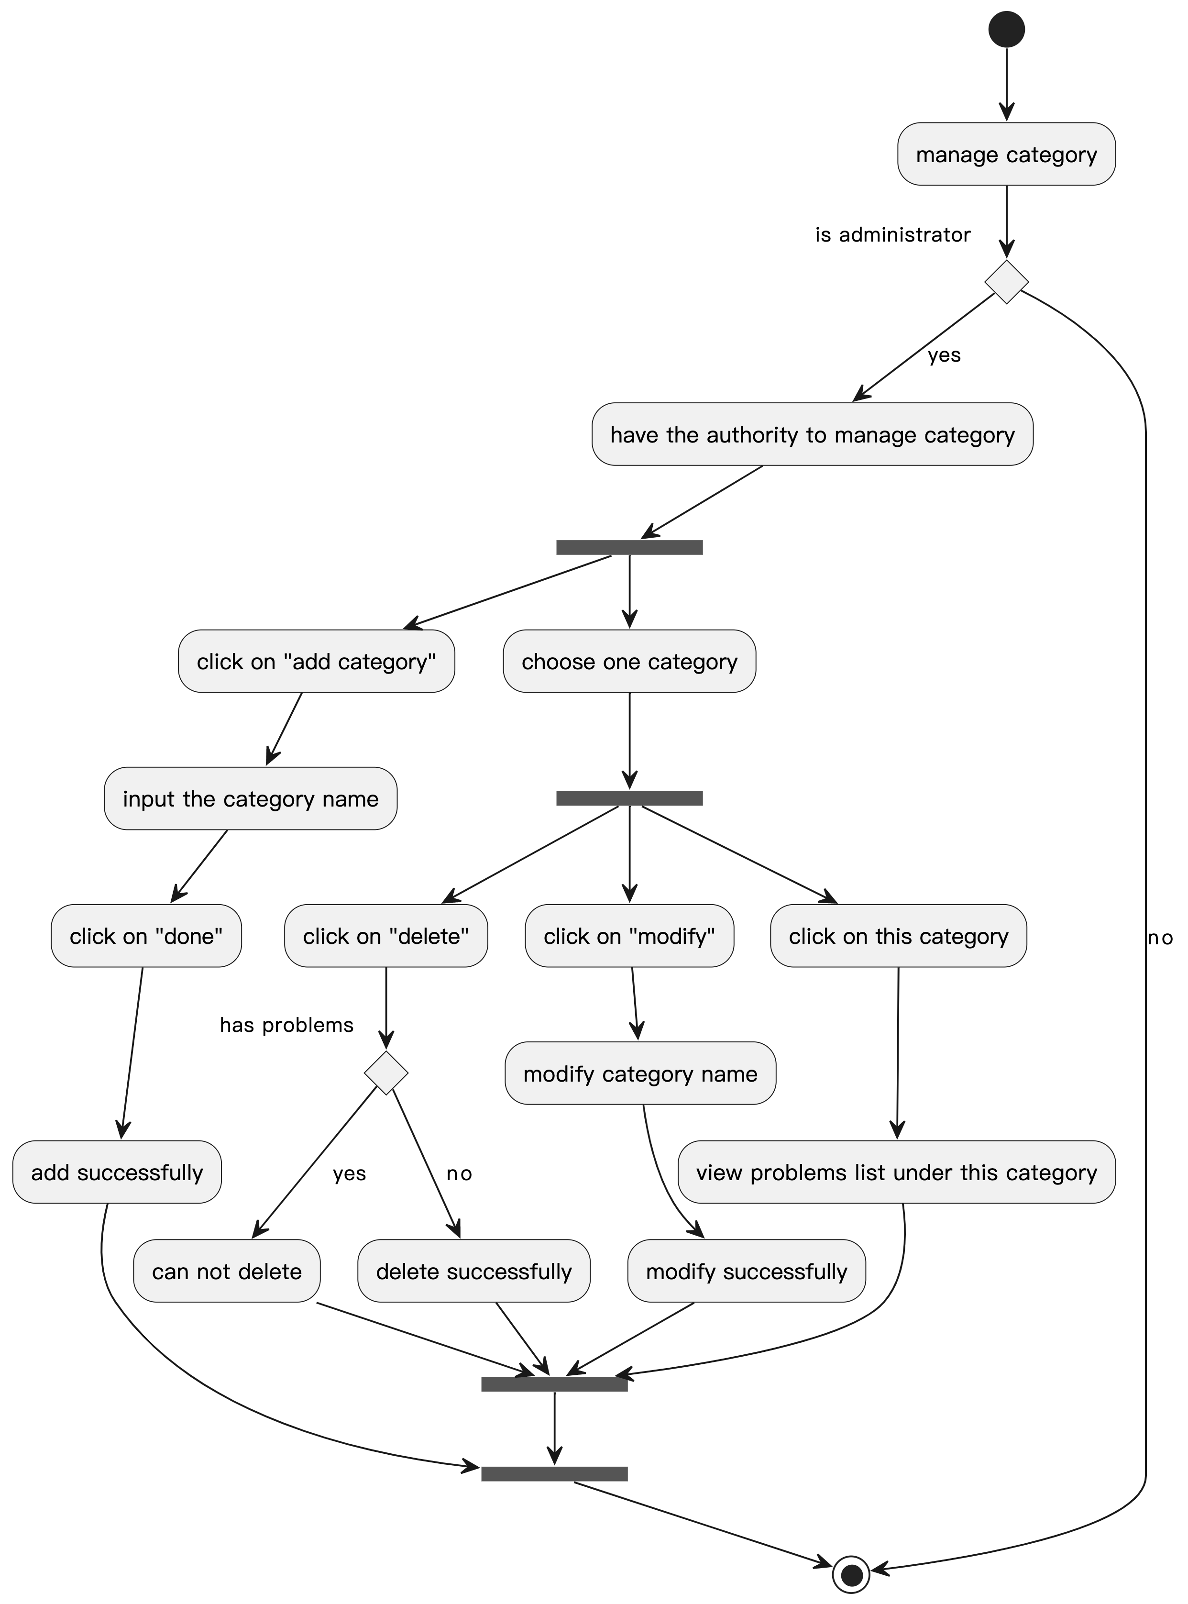
Activity Diagram
Manage Category
14

Slide 15
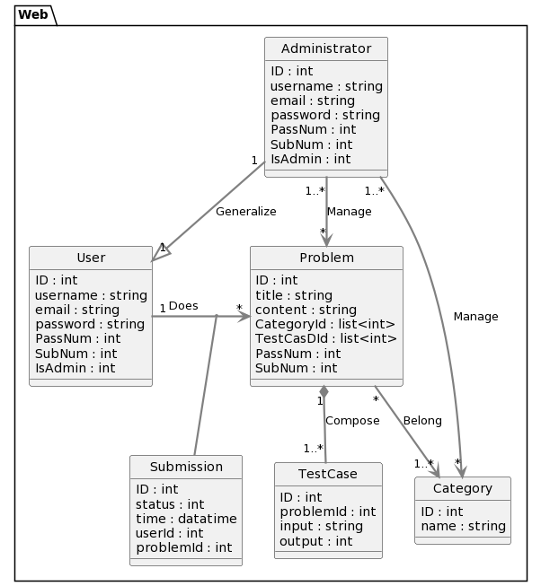
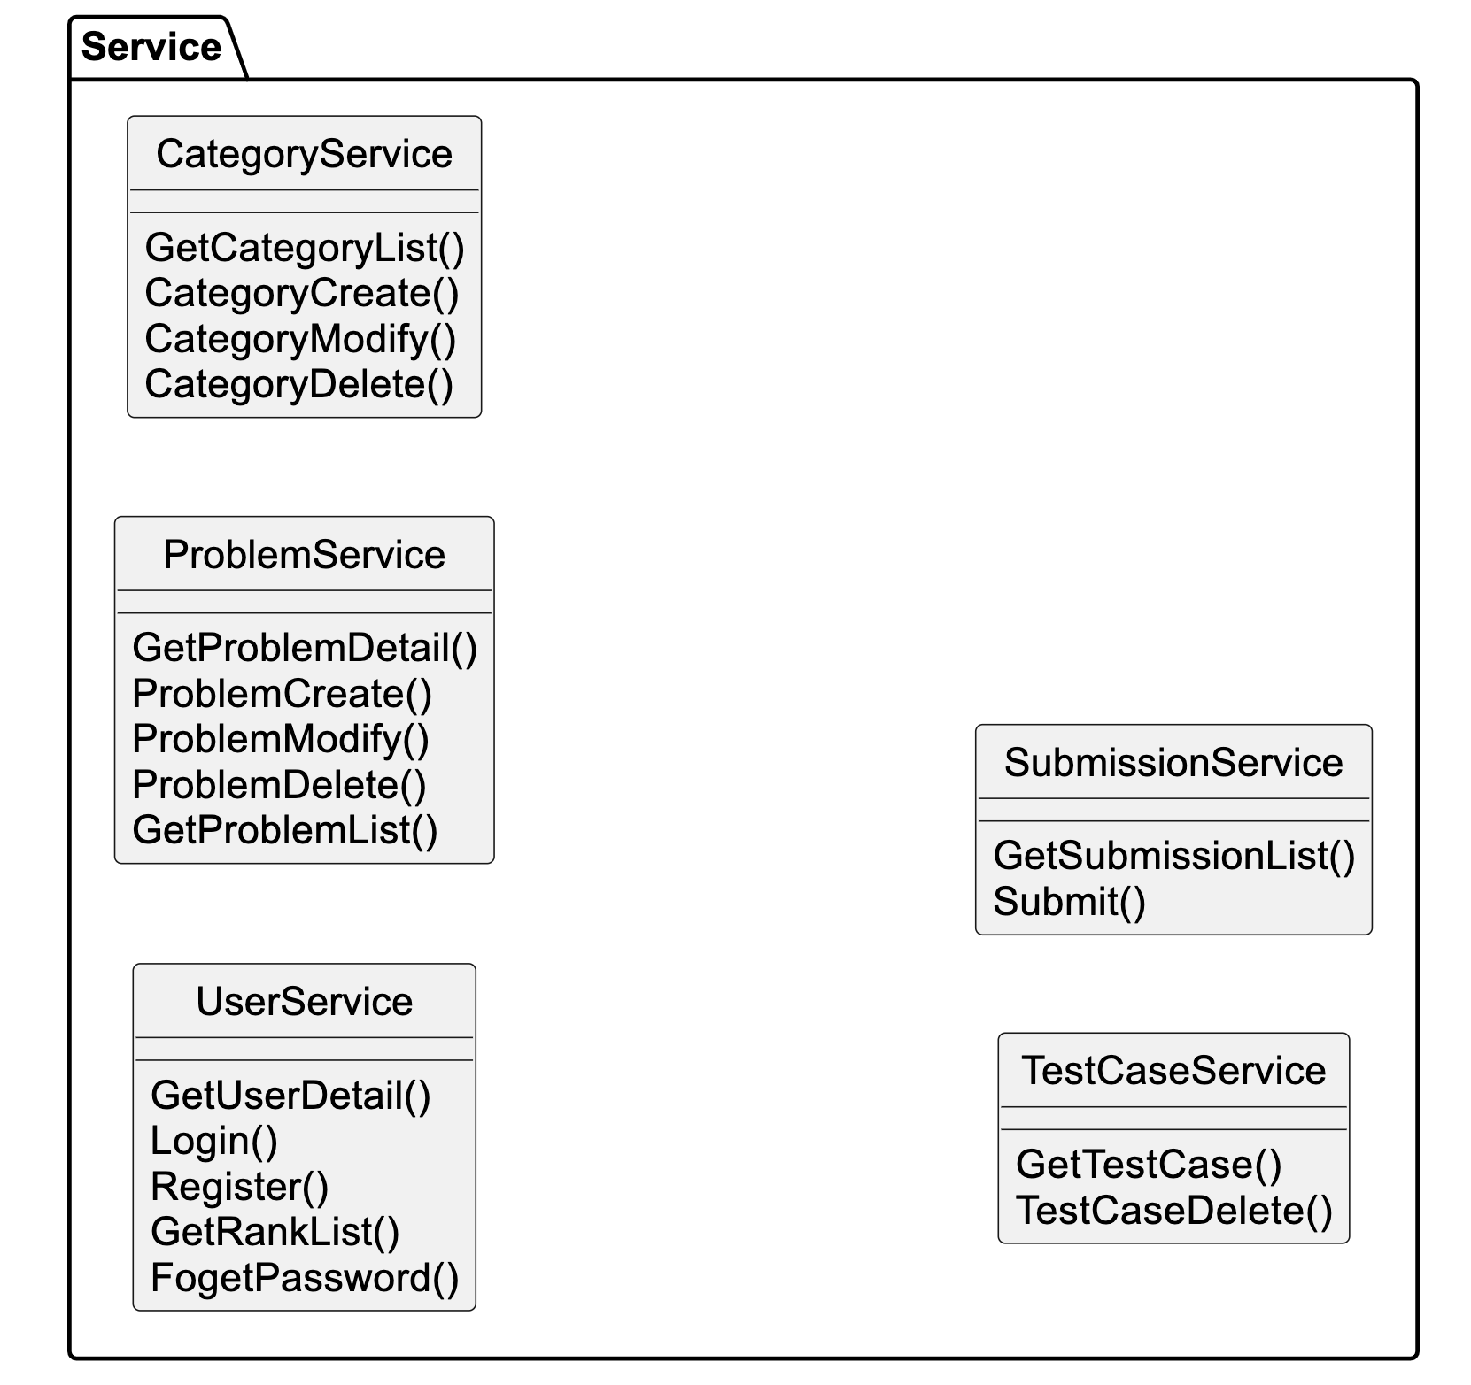
Domain Model
15

Slide 16
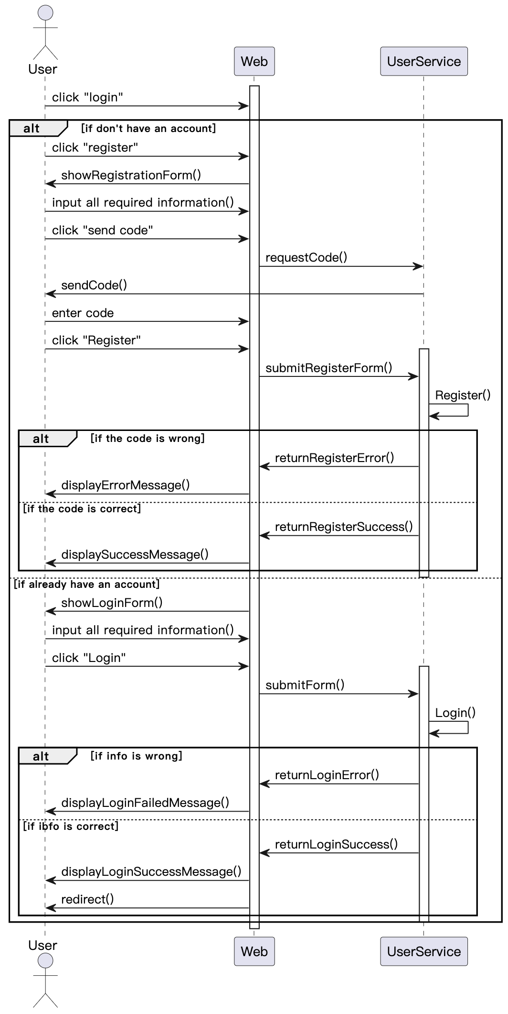
Sequence Diagram
Login
16

Slide 17
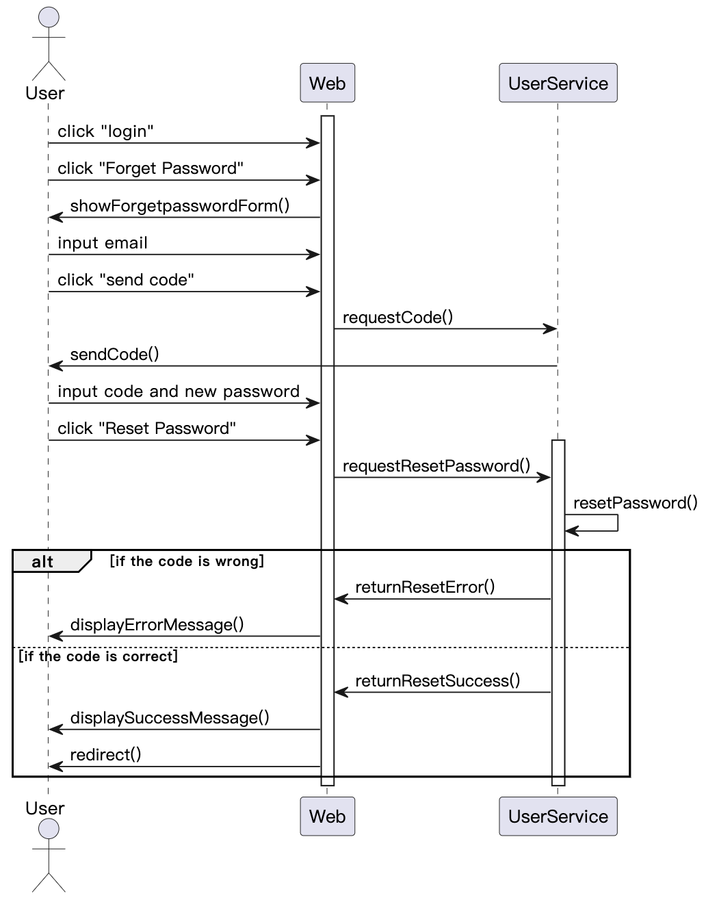
Sequence Diagram
Forget Password
17

Slide 18
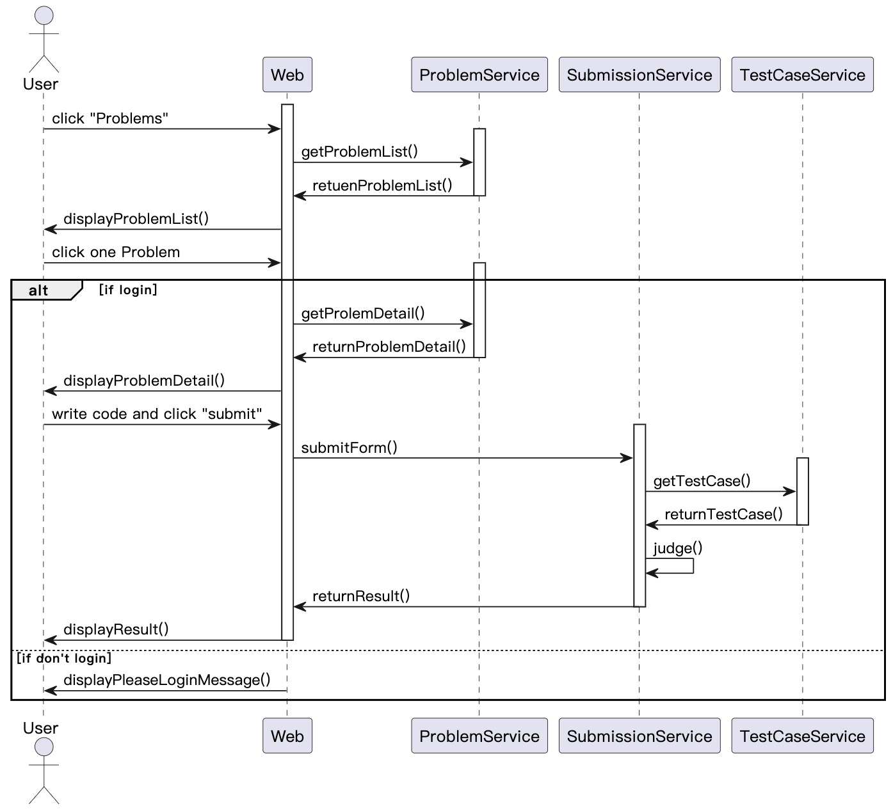
Sequence Diagram
Do Problems
18

Slide 19
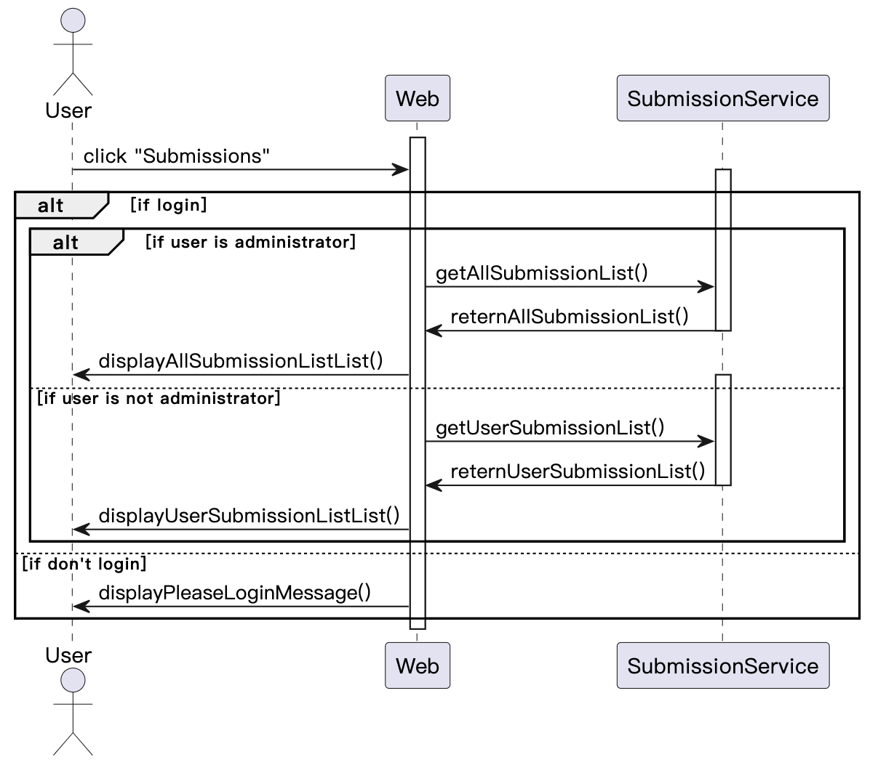
Sequence Diagram
View
Submission
19

Slide 20
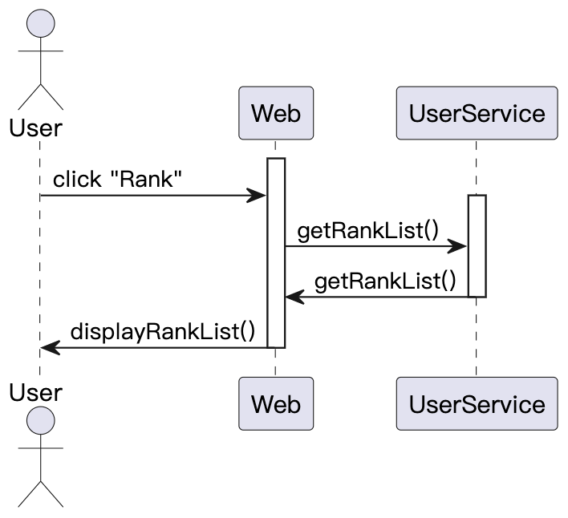
Sequence Diagram
View Rank
20

Slide 21
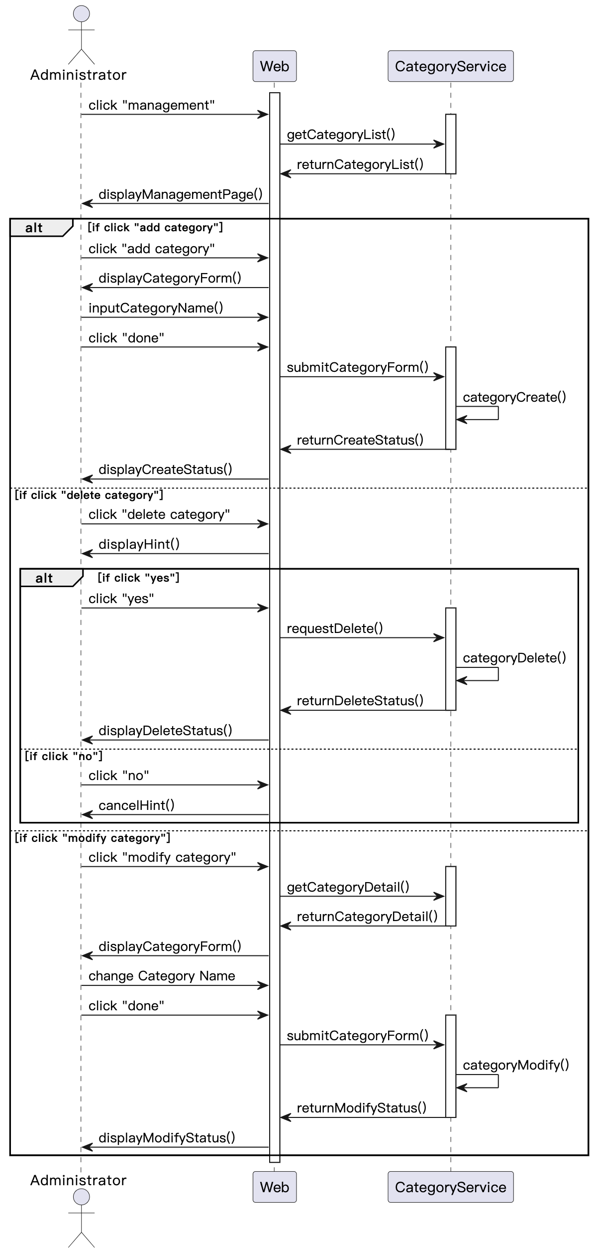
Sequence Diagram
Manage Category
21

Slide 22
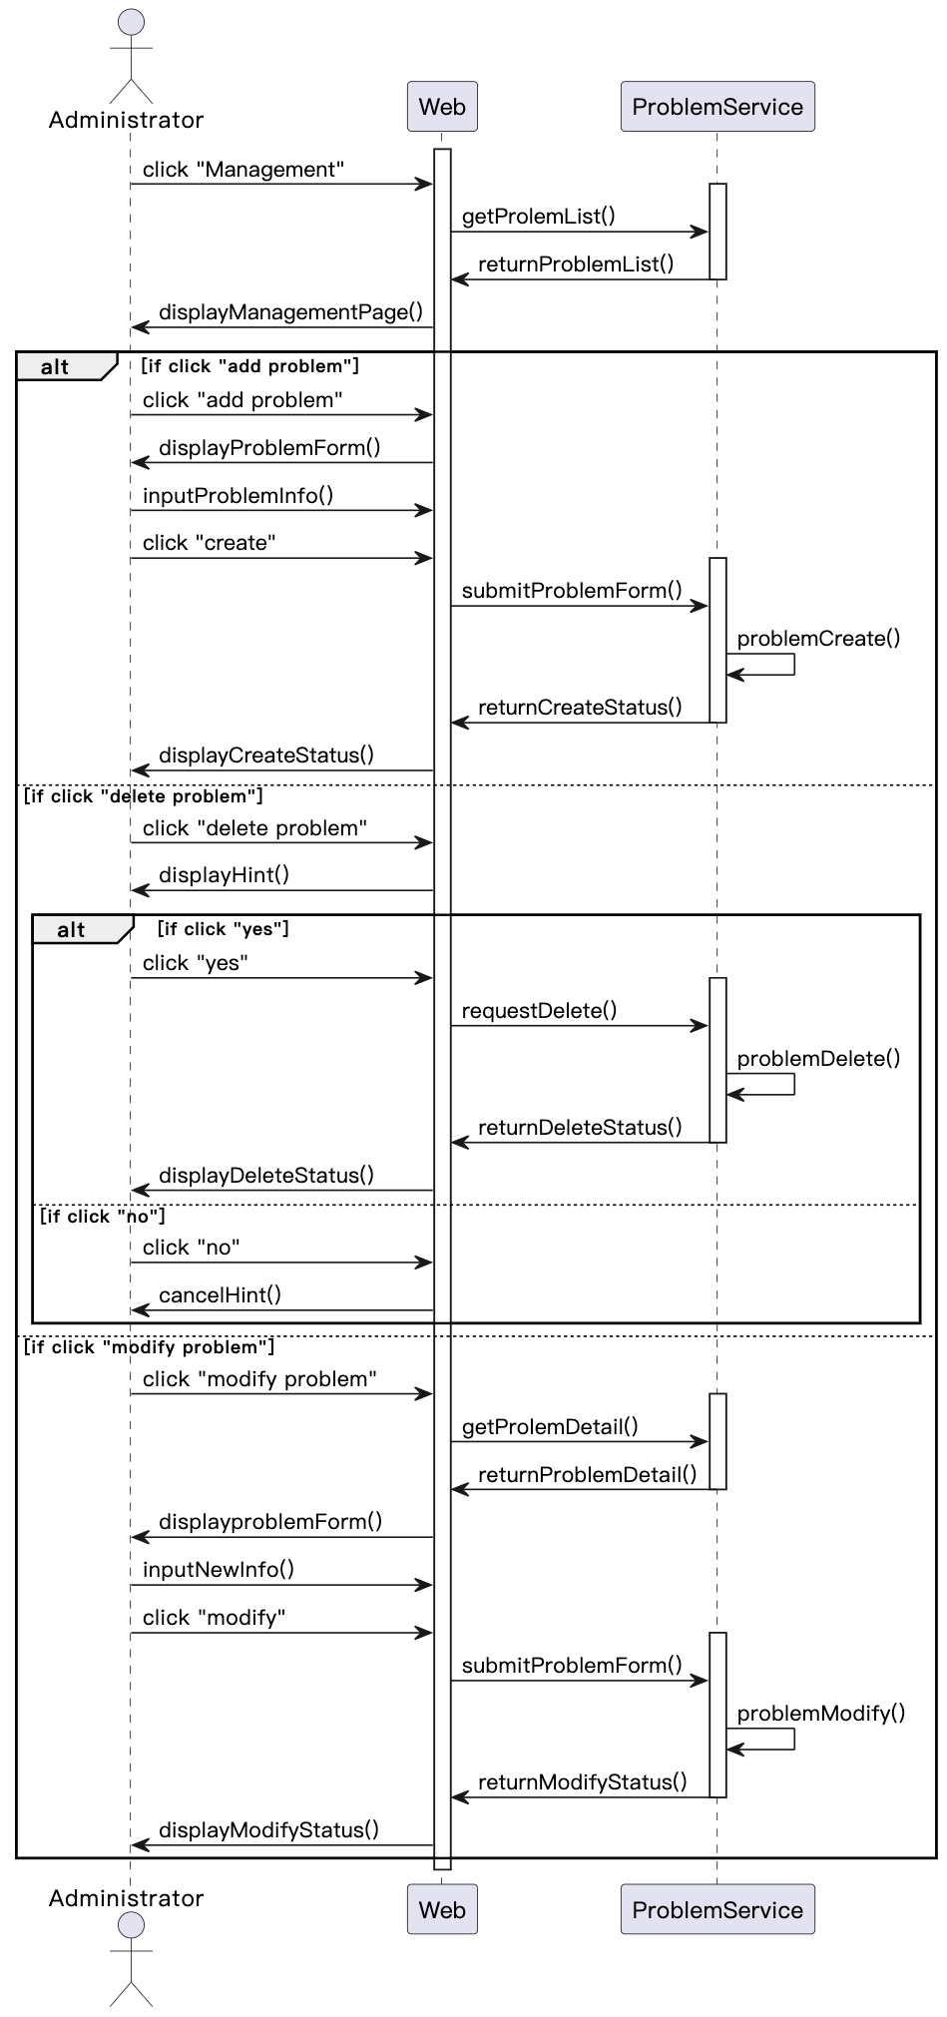
Sequence Diagram
Manage Problem
22

Slide 23
Demo
Website: 124.221.199.57
23

Slide 24
Thank you!
24

